Slide 1
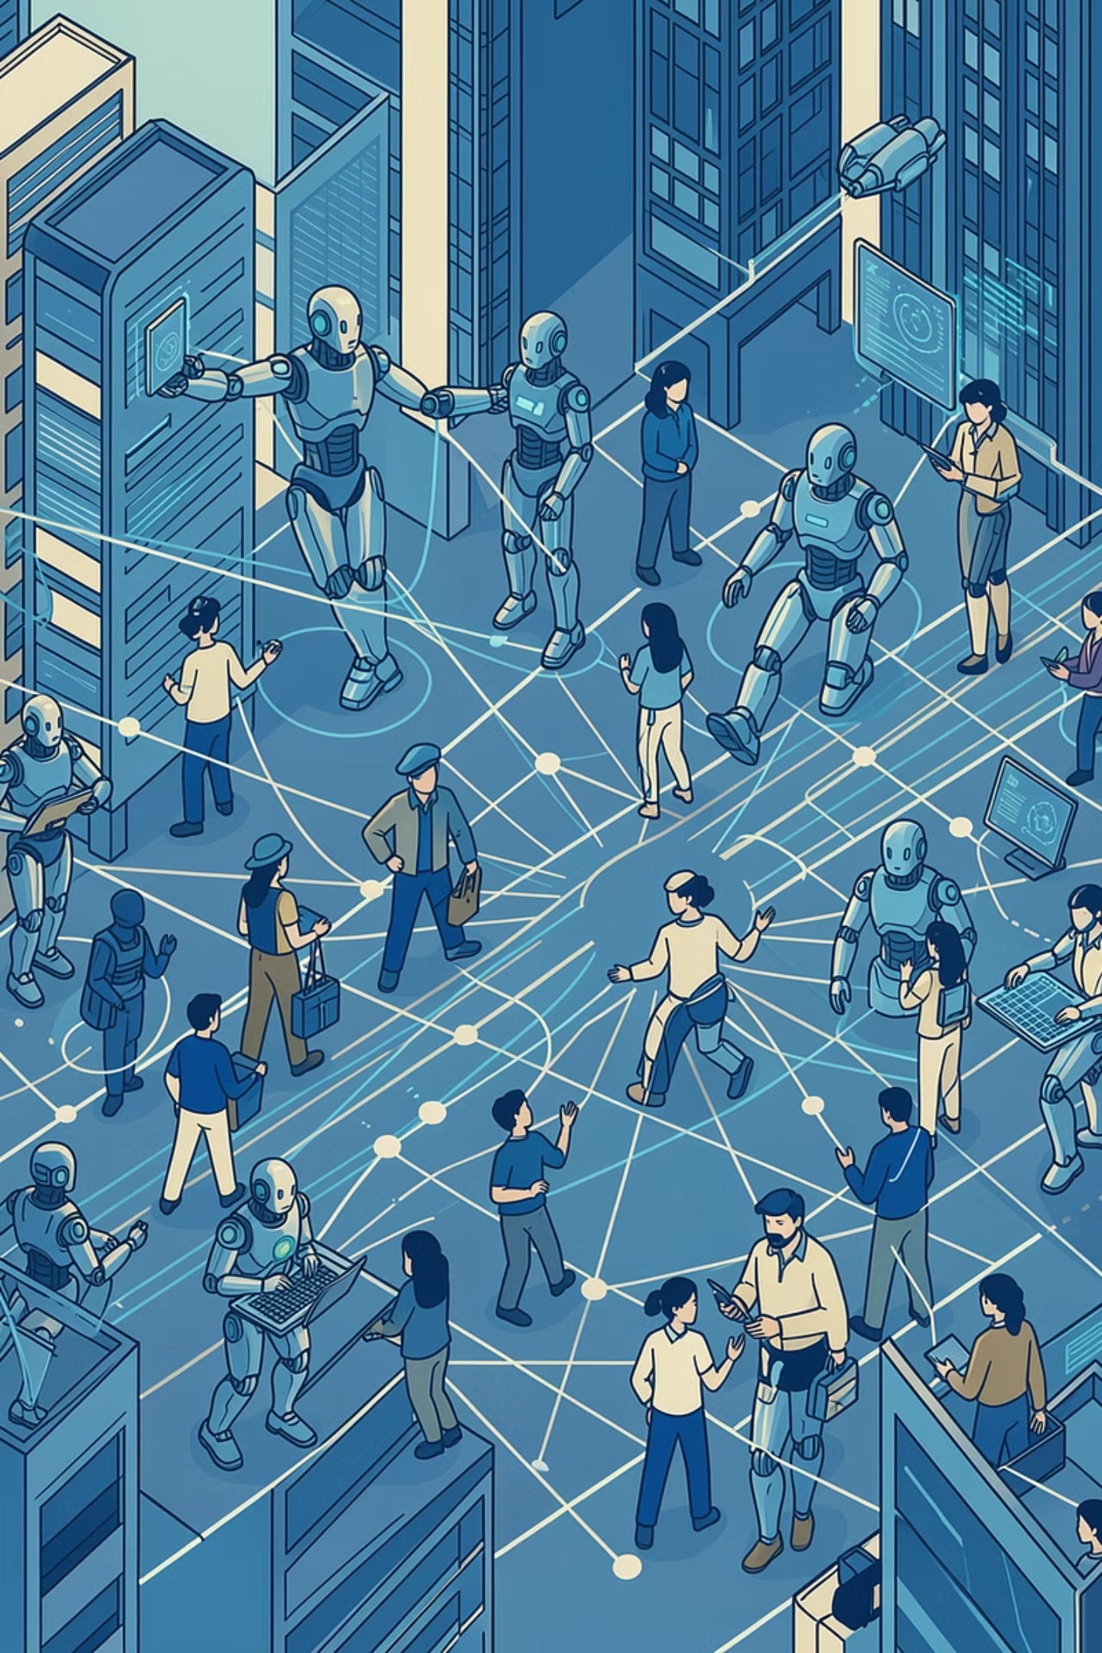
AI Society Simulator
Exploring governance, labor, and distribution pathways under AI diffusion through multi-agent social interaction
FINAL PROJECT PRESENTATION
Jingzeng Xie，Yuxi Luo，Zeyu Du

Slide 2
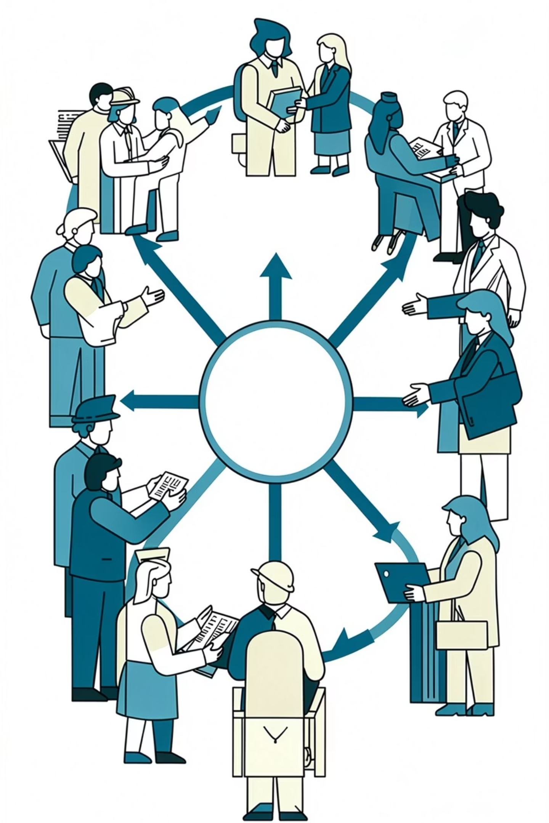
Why Simulate AI Social Transition with Agents?
After AI boosts productivity, what determines society's trajectory is not the capability of any single model — but how different stakeholders interact.
Static Parameters → Dynamic Actors
Exogenous Narrative → Forum + Proposals
Workers care about jobs, skills, bargaining power, and distribution. Employers focus on efficiency, ROI, and compliance costs.
Agents engage through open discussion, cross-role deal proposals, and coalition-building in real time.
One-way Update → Action ↔ State Loop
Government, media, unions, and academics co-shape institutional trust. Actions influence state; state influences actions.

Slide 3
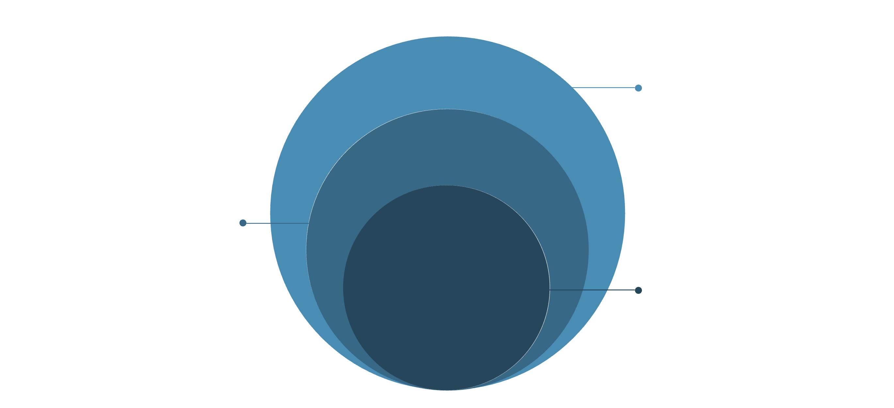
System Architecture: Agent-Driven Annual Feedback Loop
World & Output
Tech growth, updates, history and summary files
Forum Layer
Public posts, replies, cross-role proposals
Agent Layer
15 heterogeneous roles with memory
Within each year, the key sequence is fixed: technology changes enter the news first, agents then discuss and propose based on the latest state, and the world state is updated and recorded accordingly.

Slide 4
Agent Design: Heterogeneous Roles + Goal-Driven Behavior
Each agent is not a simple label — it is defined by four core elements: Role (social identity), Personality (behavioral tendency), Goal (interest objective), and Memory (short-term context).
Discuss
👷 Workers
🏢 Employers
Speak based on world state and forum context
🏛 Politicians
✊ Union
Propose Deal
Submit mutually beneficial proposals to other agent categories
🎓 Academic
💰 Investor
Decide
Form annual strategic actions and write to memory
📰 Journalist
7 social force categories across 15 heterogeneous agent instances

Slide 5

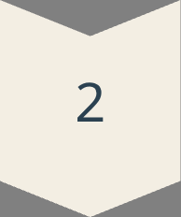
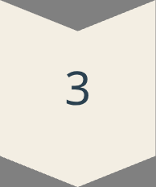




Simulation Loop: How Do Agents Change World State?
Tech Update
AI capability & productivity grow endogenously
Public News
Tech changes enter forum context as news
Multi-round Discussion
Random sampling across agent categories
Cross-role Proposals
Coalitions, negotiations, interest exchanges
Annual Decision
Each agent outputs concrete actions
World Update
LLM + rule constraints update social indicators
This design makes "discussion text" not merely display content — it becomes the evidentiary input driving next year's state changes.

Slide 6
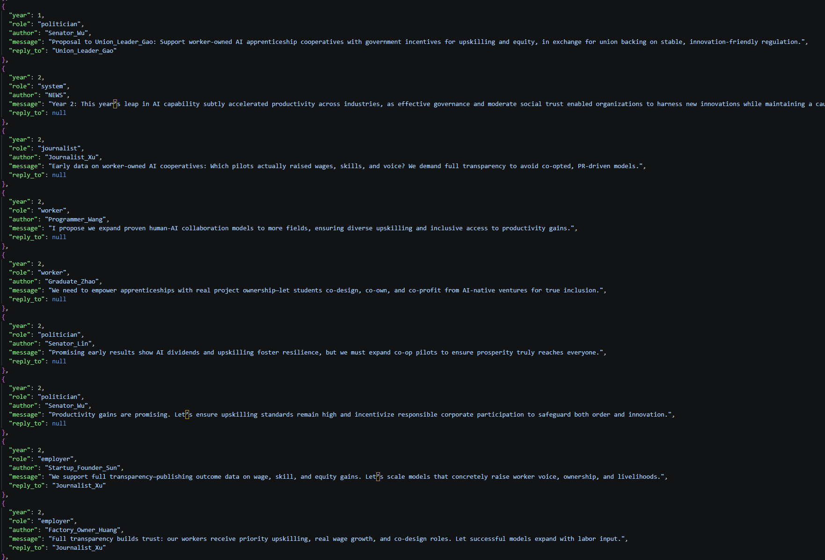
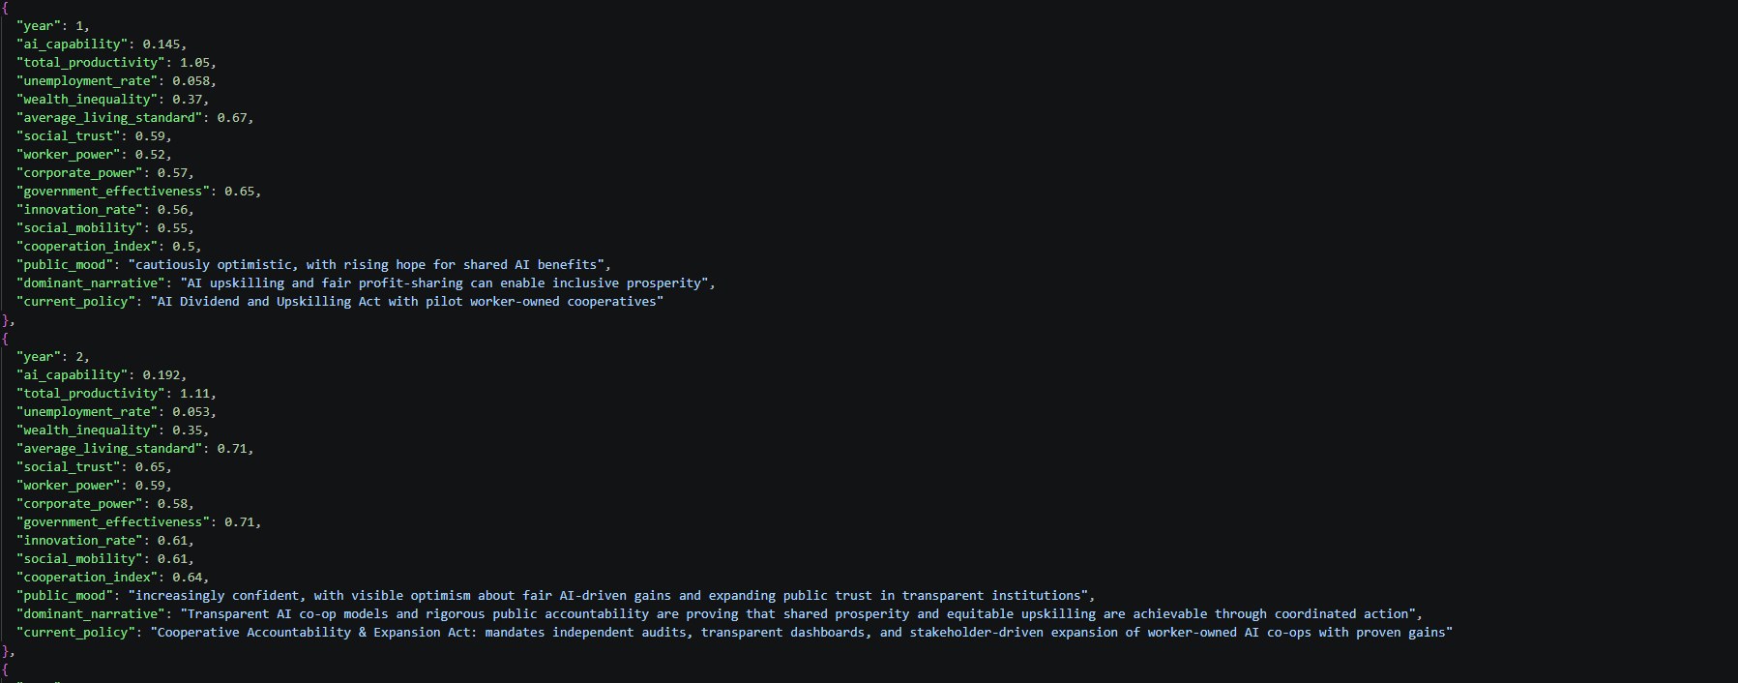

Slide 7
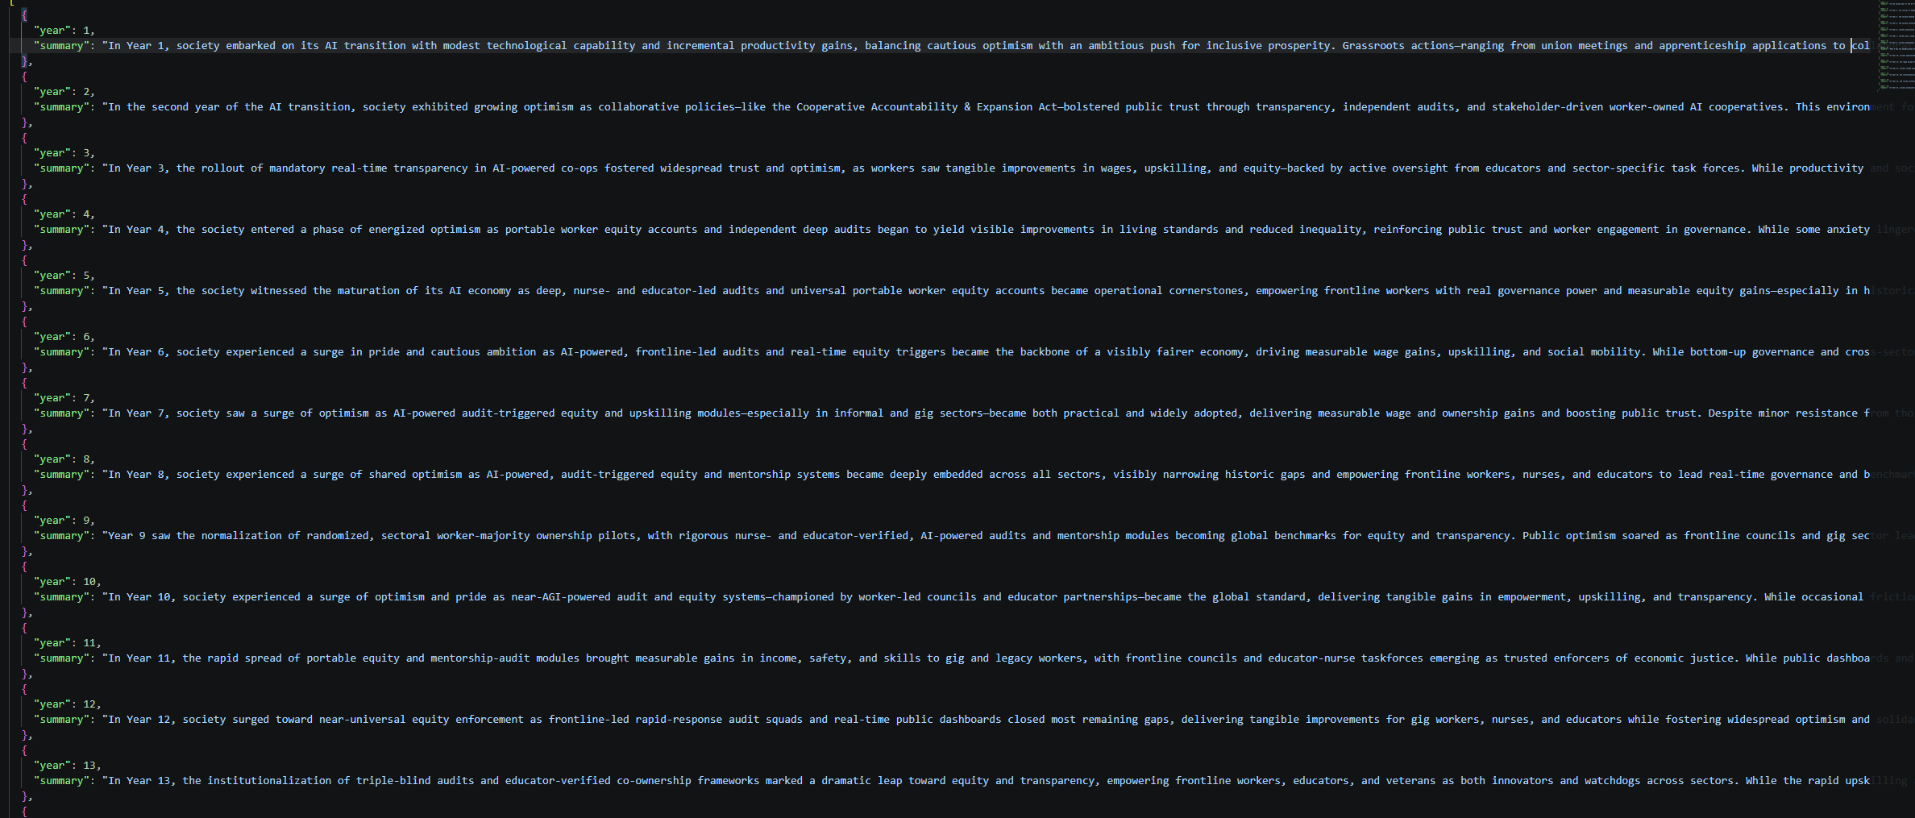

Slide 8
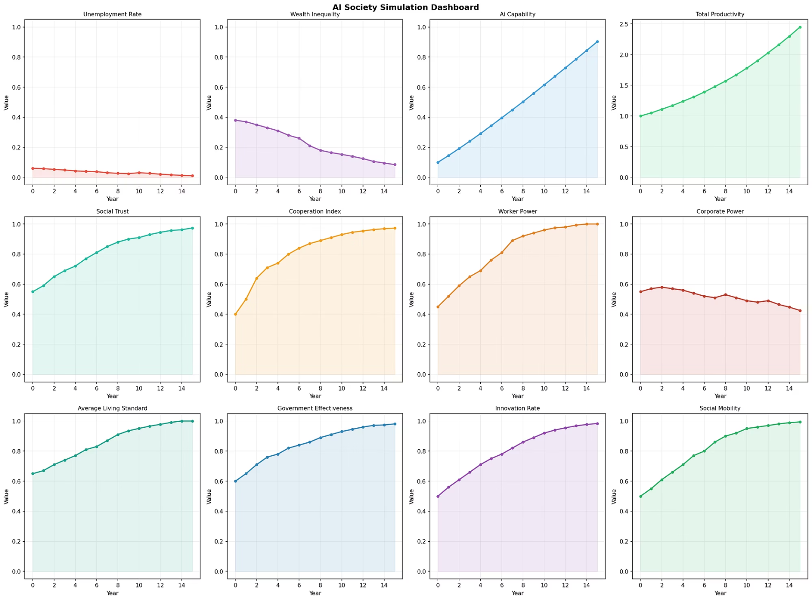
Output Artifacts: From Agent Logs to Macro Dashboard
Four Core Output Files
forum.json
history.json
Who spoke in which year, replied to whom, and what deal was proposed
All numerical states and institutional narrative fields per year
summaries.json
dashboard.png
Historian-style natural language summary for each simulation year
Trend visualization across 12 core social indicators

Slide 9
Results: This Run Produced a "Cooperative Adaptation" Pathway
0.1→0.90
1→2.45
AI Capability
Total Productivity
Continuous rise over simulation period
Significant expansion in output capacity
0.38→0.09
0.4→0.97
Wealth Inequality
Cooperation Index
Gini-style index declined substantially
Cross-agent collaboration surged
Why the Optimistic Outcome?
Representative Agent Signals
Tech growth was co-driven by innovation, corporate investment, cooperation, government effectiveness, and social trust. Agent discussions repeatedly converged on upskilling, transparent auditing, worker ownership, and profit sharing.
Journalists demanded public dashboard disclosure
Unions pushed for worker ownership stakes
Employers accepted transparent outcome reporting
Government tied incentives to audit results

Slide 10
Limitations & Next Steps: Making the Agent Society Verifiable
Current Limitations
Next Steps
A single run cannot represent robust conclusions across diverse initial conditions.
Monte Carlo multi-run experiments and sensitivity analysis across parameter space.
World updates still rely on LLM judgment without external empirical calibration.
Add agent social networks, long-term memory, and reputation mechanisms.
Agent social network structure and long-term memory remain relatively simplified.
Compare optimistic / pessimistic / high-regulation / low-regulation scenarios.
Build an interactive Web UI for parameter tuning and agent trajectory inspection.

